Slide 1

Using evidence synthesis to guide trial decisions and reduce redundancy in research
Francesca Tinsdeall
Public Engagement Showcase
18th February 2025
Notes:
So my idea for a public engagement activity is centered on exploring how researchers use (or should use) living evidence synthesis to reduce redundancy in clinical trials

Slide 2
Redundancy in randomised control trials
Redundant randomised control trials (RCTs) waste resources and unnecessarily put patients at risk of harm.
Clinical trials can be considered redundant if they do not produce new medical knowledge relevant for clinical practice.
Redundancy is often attributed to insufficient consideration of previous findings.
Notes:
So, redundant clinical trials waste resources and expose patients to unnecessary risks without generating meaningful new medical knowledge.
A trial might be considered redundant if it replicates previous studies, particularly after a drug has already received regulatory approval (_but this is excluding Phase 4 trials which assess long-term safety and efficacy in broader populations), ^or when smaller Phase 2 trials continue despite sufficient evidence to justify a large confirmatory Phase 3 trial.
A key driver of these sources of trial redundancy is the failure to systematically assess existing evidence before approving new studies

Slide 3
Redundancy in randomised control trials
Yun et al., 2024: 38.5% of RCTs from a random sample of 57 meta-analyses published between 2020 and 2021 were potentially redundant.
Jia et al., 2023: 78.8% of RCTs of treatments for STEMI conducted in mainland China between 1983 and 2020 were redundant.
Clarke et al., 2002: Only 3/30 RCTs published during May 2001 in Annals of Internal Medicine, BMJ, JAMA, The Lancet, and The New England Journal of Medicine referenced their work in the context of a systematic review of earlier evidence.
Notes:
Several studies suggest that many previously conducted RCTs have been redundant– however hopefully this is becoming less common. But to give some background to the problem, Yun et al. found that 38.5% of RCTs in a random sample of 57 meta-analyses published between 2020–2021 were redundant. Jia et al., found that 78.8% of RCTs of treatments for ST elevation Myocardial infarction in China between 1983 and 2020 were redundant. And Clarke et al., found that only 3 out of 30 RCTs published in top medical journals in May 2001 referenced their work within the context of a systematic review of prior evidence.

Slide 4
Redundancy in randomised control trials
Lau et al.,1992: Found evidence of streptokinase being lifesaving for STEMI ~15 years prior to confirmatory RCT approval
In the interim, numerous small RCTs measuring the same:
Intervention (IV streptokinase)
Disease (Acute myocardial infarction)
Patient population
Similar doses
Same primary endpoint (total mortality)
Notes:
So the inspiration for this public engagement activity was actually a landmark study published in 1992 which showed ^by means of retrospective meta-analyses, that there was good evidence from multiple RCTs, that streptokinase was lifesaving for acute myocardial infarctions up to ^15 years before the first large-scale confirmatory randomized controlled trial was conducted. *During these 15 years, numerous smaller RCTs were approved and carried out, which did not contribute new insights into the already established efficacy of the treatment. These studies were argued to be redundant because they repeatedly tested the same intervention, on similar patient groups, with comparable doses, and measured the same endpoint.
The paper argued that cumulative meta-analysis or frequent updating of meta-analyses (i.e., what we would now call living evidence) might have prevented redundant trials from being approved, and I thought that with increasing pushes for living evidence syntheses from funders, that exploring the effect that a living evidence synthesis might have had on the historical decisions that were made might be an interesting basis for a public engagement activity, which would start discussion about whether these trials were redundant, and whether a living evidence synthesis would have led to the conduct of fewer small RCTs. The activity I've envisioned would simulate the historical decision-making process but using a simulated living evidence synthesis to guide decisions, and would explore how use of such an approach might have changed historical research decisions. The activity would not only educate on the methodology of evidence synthesis but also prompt critical reflection on how we can improve ethical conduct of clinical research.

Slide 5



Intended audience
Undergraduate and Graduate students in Biomedical Sciences
ECRs not particularly familiar with evidence synthesis and/or trial design
People with ‘Lived Experience’ who are involved in co-production of research
Notes:
So the intended audience would be undergraduate and/or graduate students who have a foundational understanding of research methodologies and might be interested in living evidence synthesis because it's being talked about more and more. Potentially also early-career researchers who are not particularly familiar with evidence synthesis (or are familiar with it but from different fields e.g. systematic reviewers in computer science). Also people with lived experience who are involved in clinical research, although there would probably have to be some guidelines on required knowledge for engaging in the activity. However I think this is a really important group to engage with because of the increasing application of co-production in research, particularly clinical trials, where lived experience groups can have a real influence on trial design.

Slide 6
Aims of interactive activity
Increase basic familiarity with evidence synthesis techniques/interpreting forest plots
Encourage participants to view previous decision-making processes critically
Promote discussion about using all available evidence in decisions to progress from one clinical trial phase to the next
Notes:
So regarding aims, I'd firstly like to increase participant familiarity with evidence synthesis methods and interpretation of forest plots: to hopefully increase their literacy in reading and understanding these scientific results.
Encourage participants to view previous decision-making processes critically: and this is really just to engage them in thinking critically about how decisions used to be made and how the research community is trying to improve that by making better use of the existing evidence.
And then finally to promote discussion about the importance of using all available evidence when making decisions to progress from one clinical trial phase to the next. This is with the aim of encouraging participants to weigh the practical and ethical considerations in trial design, such as resource allocation, risk to participants, and the overall impact on medical practice. For example, pros of continuing with smaller phase 2 trials might be to increase confidence in preliminary evidence of efficacy and safety before conducting a large-scale phase 3 study to minimise the number of patients ^exposed to a treatment which ^might still be seen as risky. On the other hand, if there is already good and stable preliminary evidence of efficacy, continuing to randomise patients to receive what is already ^known to be an inferior treatment means that patients could be harmed by their participation in the trial.
Overall, I would hope that by increasing participant familiarity with evidence synthesis methods and the role of living evidence in facilitating informed trial design, participants might have greater confidence to challenge trials that they are involved in now or in the future which are at risk of being redundant and so ethically questionable.

Slide 7
Initial primer session
Introduction to what a meta-analysis is
Briefly cover the difference between a fixed and random effects model
Brief overview on reading a forest plot
Notes:
So in terms of how the activity would actually run, you’d probably need an initial primer session to get people onto a similar basic knowledge level.
You’d want a brief introduction to what meta analysis is – i.e., that it is a statistical method which is used to synthesise quantitative data from multiple independent studies addressing a common research question, and that advantages include an improvement in precision and the opportunity to settle controversies arising from conflicting claims. Then briefly cover the difference between a fixed and random effects model, so introducing the idea that fixed effects models assume that the true effect size is constant across all studies (used when we believe that all studies are sampling from the same underlying population), and that a random effects model assumes that the true effect size is not constant across studies (due to differences in study conditions or populations), and so tends to have larger 95% confidence intervals. Then would provide an introduction in how to read forest plots, which are used to visualise the findings of a meta-analysis.

Slide 8


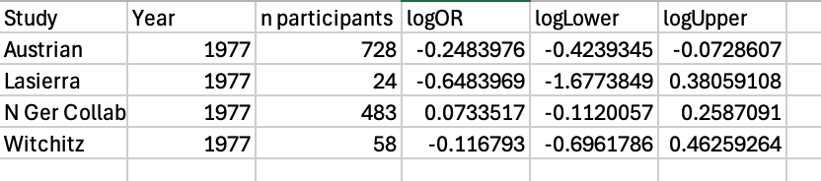
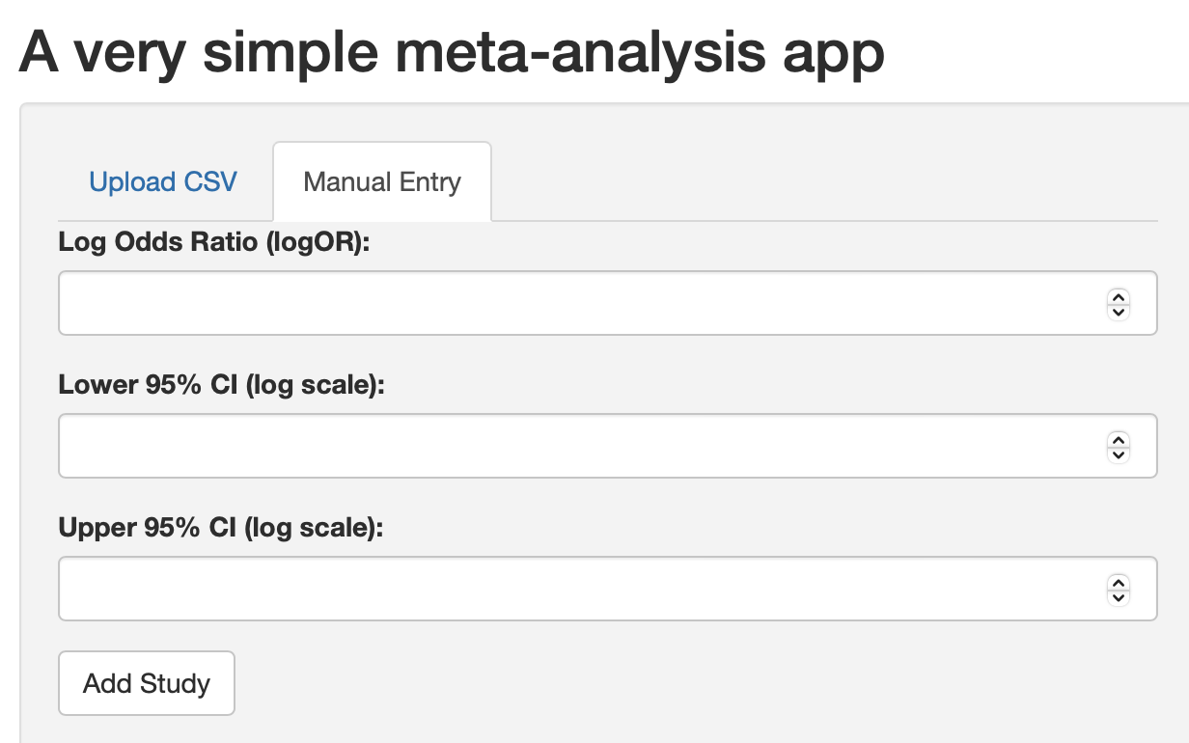
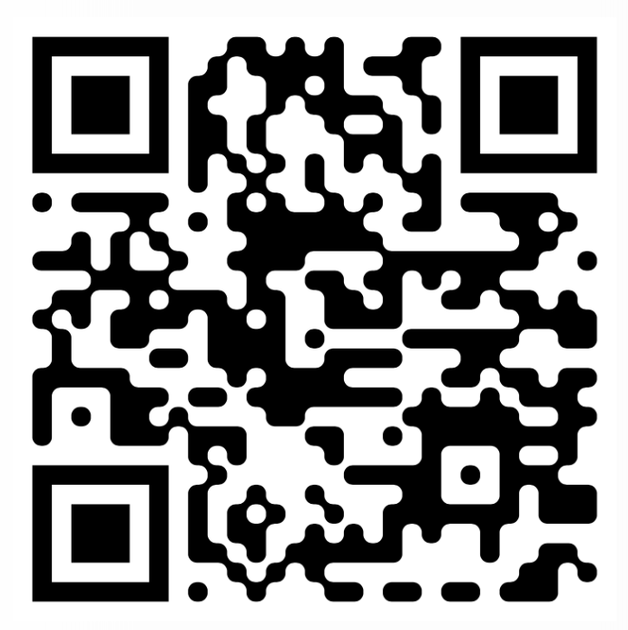
Overview of interactive activity
Round 1 = 1969
Studies published in 1977
Round 2 = 1973
Regulatory board
Round 3 = 1975
Round 4 = 1976
…
Round 16 = 1988
(hopefully, people would have ‘called their shot’ before this)
1969
1980
Link to github with ShinyApp (if interested…)
Notes:
In the interactive activity, participants would assume the role of a regulatory body tasked with approving clinical trials. They would use a 'simple' meta-analysis app (which I've made) to iteratively input and analyse cumulative data from 33 randomized controlled trials (RCTs) of intravenous streptokinase for acute myocardial infarction, spanning from 1959 to 1988.
The activity would be structured in a series of rounds, each round representing the conclusion of a period of time. Early rounds would cover every two years to accumulate initial data and would start from the end of 1969, because meta-analyses, by definition, require at least two studies, but from then on each round would represent a calendar year. At the end of each designated period, participants will receive an envelope containing details of the studies published within that period – with details of the number of participants, trial names, and effect size data. This information is then entered into the app, which conducts both fixed and random effects meta-analyses and provides the output. Participants use these results to make informed decisions on whether to continue funding smaller trials or to consolidate resources into a single, large confirmatory trial.
To visually represent decisions of the group, a physical timeline will be set up at the front of the room. Participants would go and place a marker on this timeline to indicate their chosen timepoint to transition to larger trials.
The activity continues until each participant has placed their marker. Afterward, the actual historical outcomes will be revealed and discussed, allowing participants to compare their decisions with real-life events

Slide 9
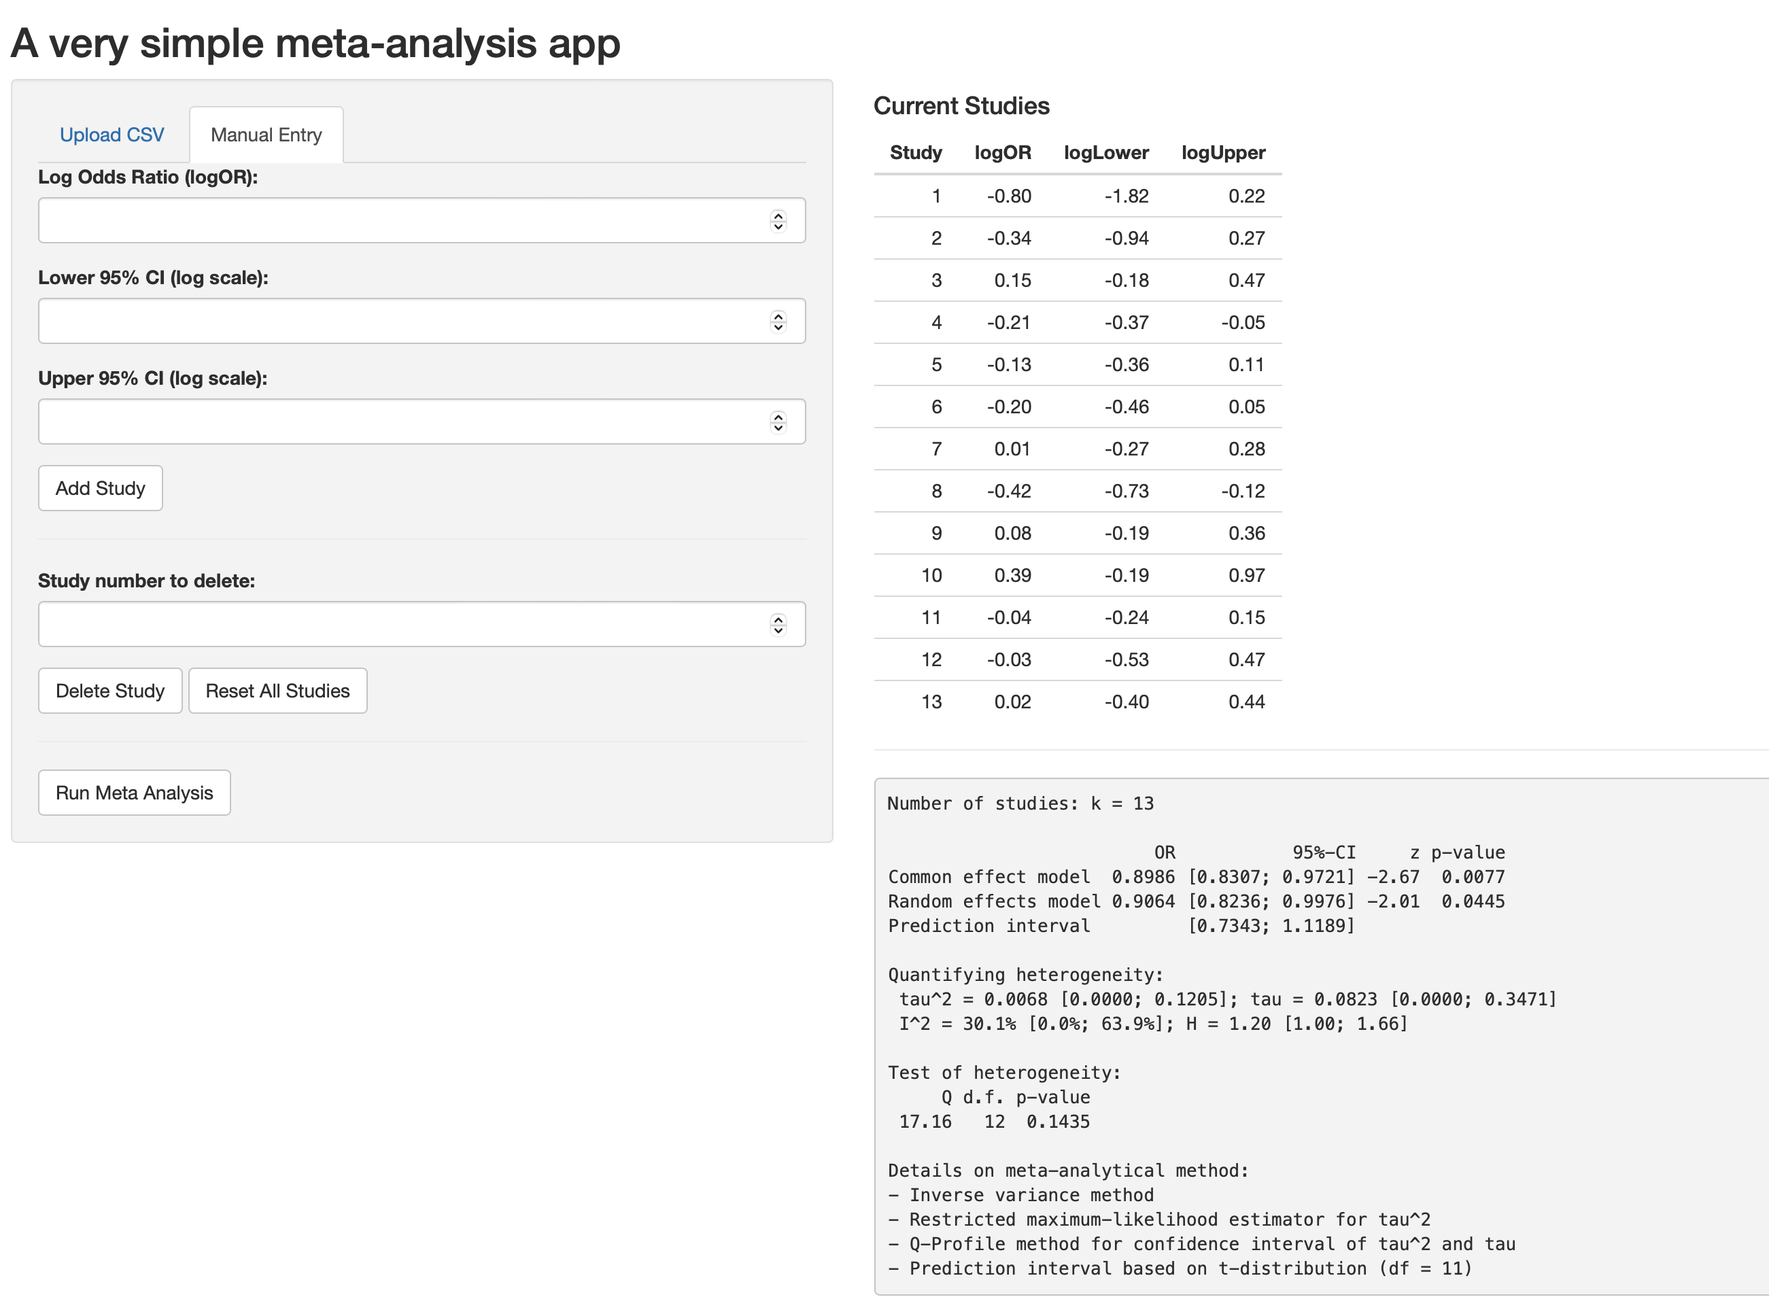
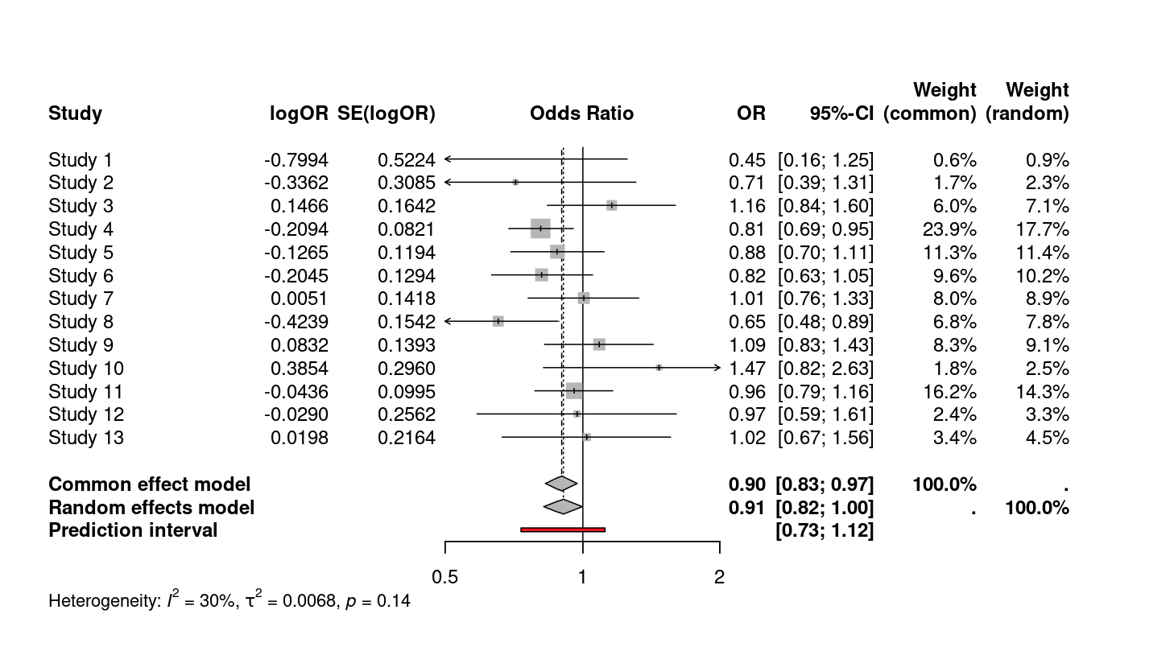
What app outputs look like
After reviewing the cumulative evidence from previous studies at each ‘round, they must decide:
Do we approve another small trial?
Do we pool resources into a large confirmatory trial?
Notes:
So this is what you would see as an output from the app, you get the confidence interval and p value of the meta-analysis as well as the forest plot, and yeah, just to emphasize, the question the participants are asking themselves is whether they think they have sufficient evidence of efficacy to want to perform a confirmatory trial, or whether they want to see the results of more small studies before committing to this.

Slide 10
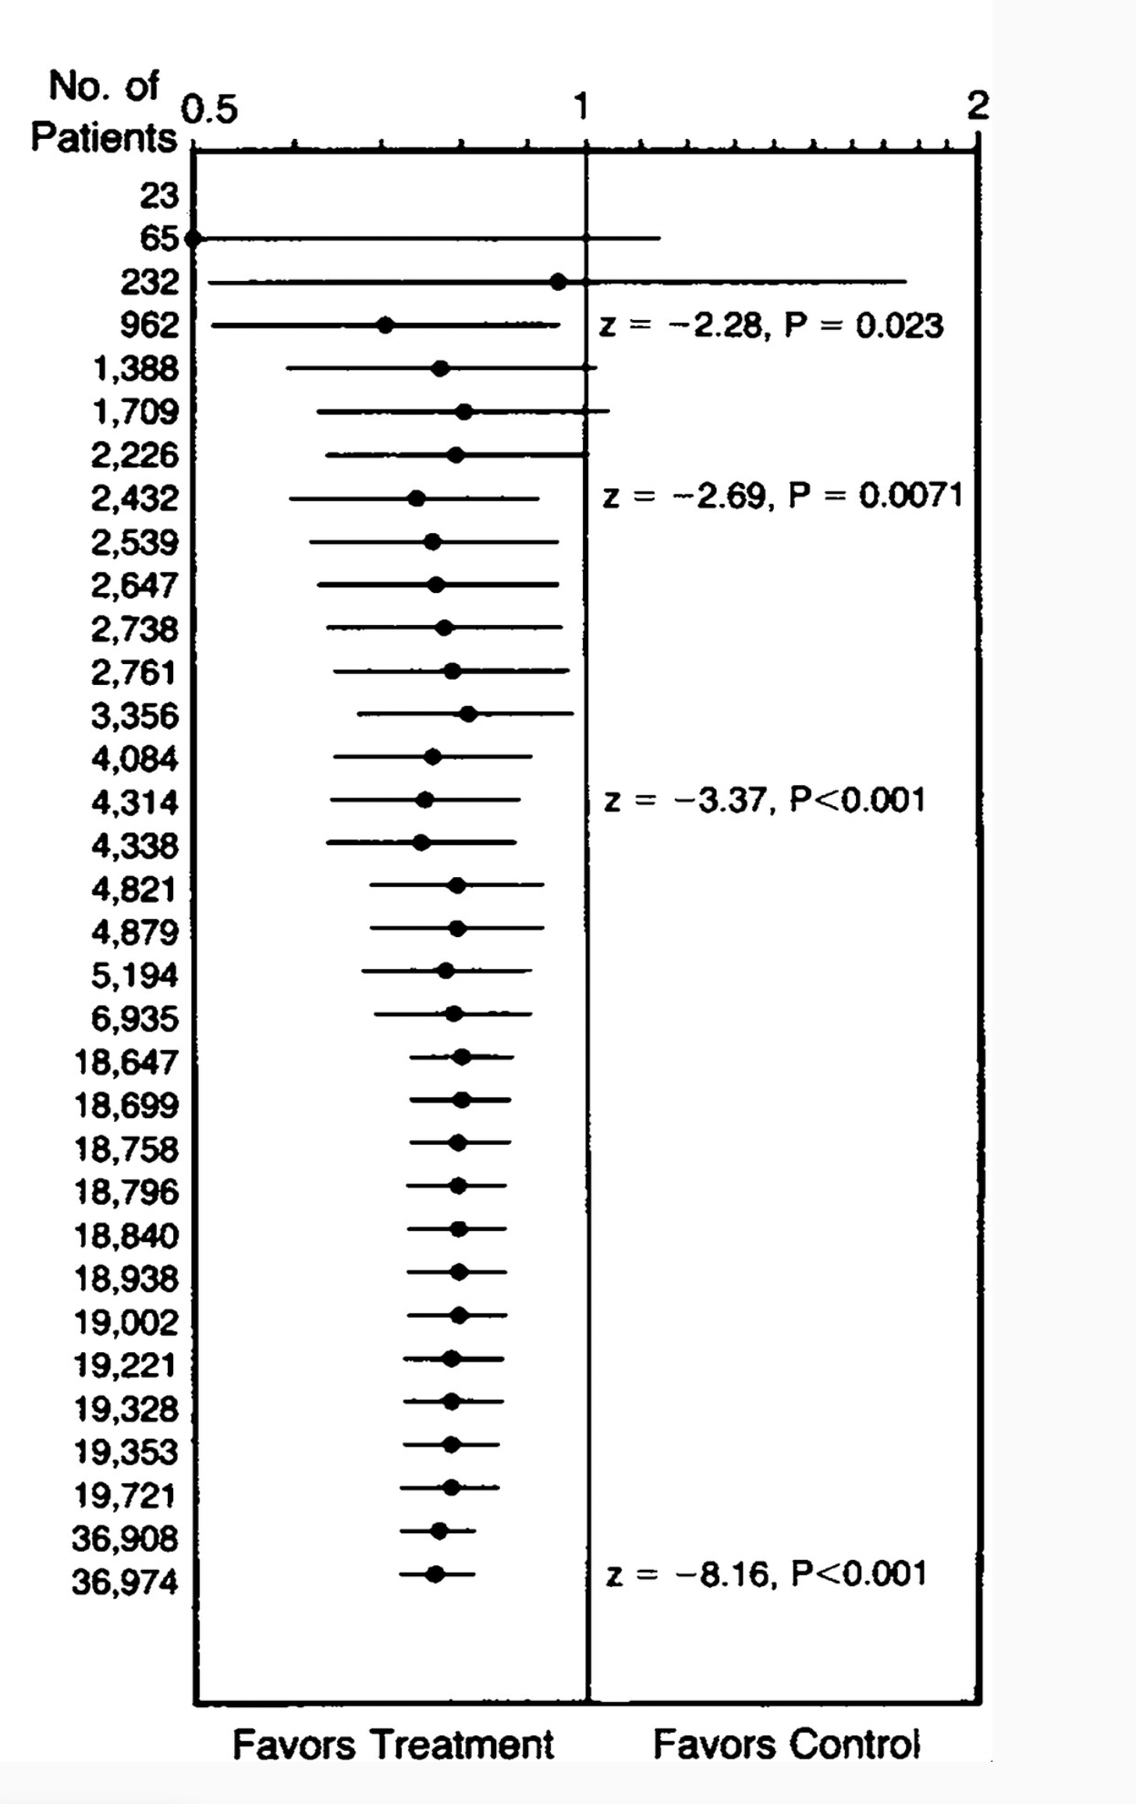
What would they see over rounds?
Cumulative meta-analysis of the studies used in the interactive task (taken from Lau et al., 1992)
Notes:
As they went through year by year, they would see that quite early on, that the effect size stabilized, showing a positive effect, and that additional trial results weren’t changing the direction or magnitude of the pooled effect size very much, and were just narrowing the confidence intervals.

Slide 11
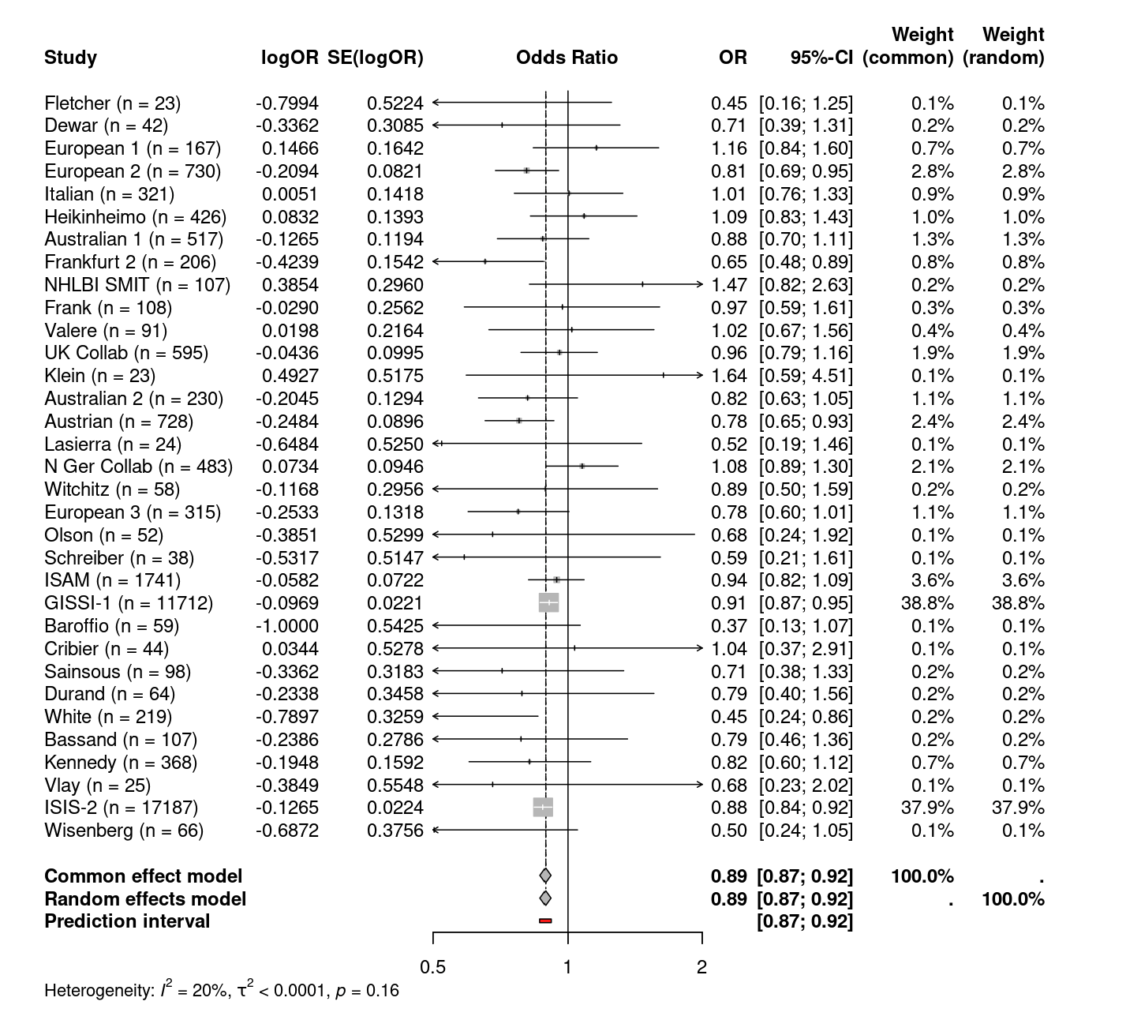
Review of real-life decisions about trials
Random effects p value was 0.0141 in 1979
1st large confirmatory trial (approved 1984)
Same evidence base for large and small RCTs
2nd large confirmatory trial (approved 1985)
(RE) p < 0.001
Notes:
So, after everyone had called their shot and made their decision, we would then compare to what actually happened in the absence of living evidence syntheses. In examining the historical timeline of clinical trial approvals a significant delay becomes evident. Despite achieving a statistically significant p-value of 0.014 by 1979, which strongly indicates potential efficacy, it wasn’t until 1984 that the first large-scale trial was initiated. During the intervening five years, three additional smaller trials were approved. Moreover, following the commencement of this large trial, eight more small trials were approved before a second large-scale trial began.
*
Furthermore, the trials I’ve just mentioned, highlighted in the red box, were all approved based on the same body of evidence as no new study results were published in the timeframe that these trials were getting approved. The approval of trials of varying sizes and phases based on exactly the same evidence base indicates inconsistencies among different stakeholders regarding the interpretation of existing evidence. This could imply that there was no unified standard or threshold of evidence deemed sufficient to move directly to larger trials, or just be the direct result of absence of up-to-date evidence syntheses to disseminate this information.

Slide 12
Post-activity discussion points
After reviewing historical trial decisions, participants will reflect on:
Perceived impact of living evidence on decision making:
Would not having had access to continuously updated meta-analyses changed their decisions?
Do they think lives may have been saved if living evidence had been used?:
Do they think a continuous evidence synthesis in real life would have led to an earlier initiation of a large confirmatory trial, potentially accelerating clinical adoption?
Role of up-to-date evidence in trial approval:
Should ethics committees or regulators have mandated systematic reviews with meta-analysis before approving trials?
Notes:
After reviewing historical trial decisions, participants will reflect on:
1. The Perceived impact of living evidence on Decision-Making: Do they think that they would have made different decisions if they didn’t have access to continuously updated meta-analyses?
2. Considering that the primary outcome being measured was total mortality, do they think lives might have been saved if living evidence had been used: Do they think a continuous evidence synthesis in real life would have led to an earlier initiation of a large confirmatory trial, potentially accelerating clinical adoption, and reducing deaths from acute myocardial infarctions in the years where streptokinase would have represented first line treatment?
And finally, should ethics committees have mandated systematic reviews with meta-analyses before approving trials? There is not a right answer to this, it is not necessarily always a yes, because it can delay starting a trial – so there might be some interesting discussion about this.

Slide 13
Considerations
Nuances of evidence synthesis methods not discussed.
Nuances of trial design not discussed.
Significant simplification of trial approval process.
Some participants may get confused – facilitators needed.
Participants need to be able to come with a laptop.
Safety risk low
Thank you!
Notes:
The workshop would not cover complex aspects of meta-analysis in depth, such as sources of heterogeneity, measures of heterogeneity, and methods such as hierarchical models and subgroup analyses. This could limit participants' understanding of how to interpret and apply meta-analysis results in nuanced scenarios. But you could provide supplementary materials or resources for participants who wish to explore these topics in greater depth.
The workshop does not address newer and more complex clinical trial designs, such as multi-arm trials or adaptive designs. Again, you could provide signposts to resources. It also significantly simplifies the trial approval process.
Due to the technical nature of the topics discussed, some participants, may find the content challenging. For mitigation you would need to ensure that facilitators are available to assist participants.
The necessity for participants to bring a laptop might limit the accessibility of the workshop for some individuals. As mitigation, you could set up a few stations with computers that participants can use during the workshop – however, I would assume that most university students and ECR’s do have access to a laptop, and so this is only really a concern for patients with lived experience.
But on a positive, the safety risk would be low.

Slide 14
References
Jia, Y., Liang, J., Wang, W. et al. Assessment of redundant randomized clinical trials among patients with ST segment elevation myocardial infarction. BMC Med 21, 69 (2023). https://doi.org/10.1186/s12916-023-02749-2
Yun, Q. et al. (2024) ‘Prevalence of and factors associated with potentially redundant randomized controlled trials: a cross-sectional study’, Journal of Clinical Epidemiology, 167, p. 111265. Available at: https://doi.org/10.1016/j.jclinepi.2024.111265.
Clarke, M. (2002) ‘Discussion Sections in Reports of Controlled Trials Published in General Medical Journals’, JAMA, 287(21), p. 2799. Available at: https://doi.org/10.1001/jama.287.21.2799.
Lau, J. et al. (1992) ‘Cumulative Meta-Analysis of Therapeutic Trials for Myocardial Infarction’, New England Journal of Medicine, 327(4), pp. 248–254. Available at: https://doi.org/10.1056/NEJM199207233270406.

